Slide 1
MY FIRST EXPERIECE IN NAIROBI
a place to be
Presentation by monica adhiambo

Slide 2
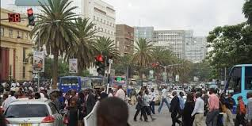
Mass of people

Slide 3
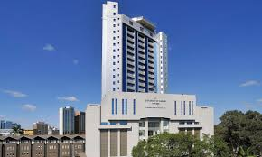
Uon towers

Slide 4
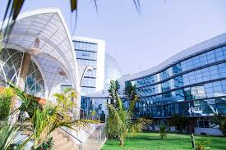
The Boma Nairobi hotel

Slide 5
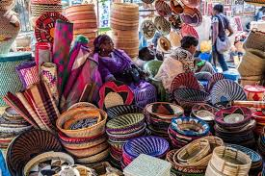
Maasai market

Slide 6
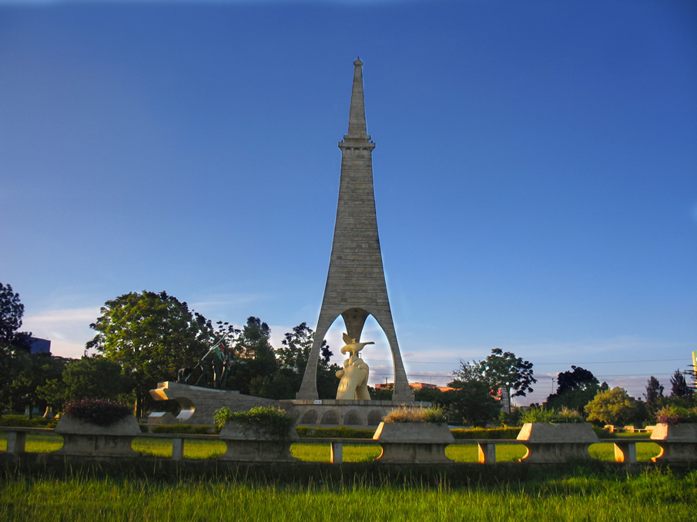
Uhuru gardens

